Slide 1

CREDIT CARD FRAUD DETECTION
Project Supervisor: DR.JEMSHIA MIRIAM
Name of the Student:GRANDHI GOWRI SANKAR
Register Number:40110404

Slide 2
Presentation Outline
Course Certificate
Introduction
Objectives
System Architecture / Ideation Map
Module Implementation
Application Snapshots
Results and Discussions
Conclusion & Future work
References

Slide 3

Course Certificate

Slide 4
Introduction
Credit card fraud is a form of identity theft that involves an unauthorized taking of another’s credit card information for the purpose of charging purchases to the account or removing funds from it.
In this project, we will develop a machine learning model using classification algorithms and techniques to accurately detect if a credit card transaction is fraudulent or not. We will also deploy our model as an API using FastAPI and create a frontend interface using Streamlit to access our API.

Slide 5
Objectives
Identify and Describe examples of credit card
frauds.
List ways to protect yourself from credit card fraud
in card present and card not present scenario.
Be aware with upcoming technologies in the concerning field

Slide 6
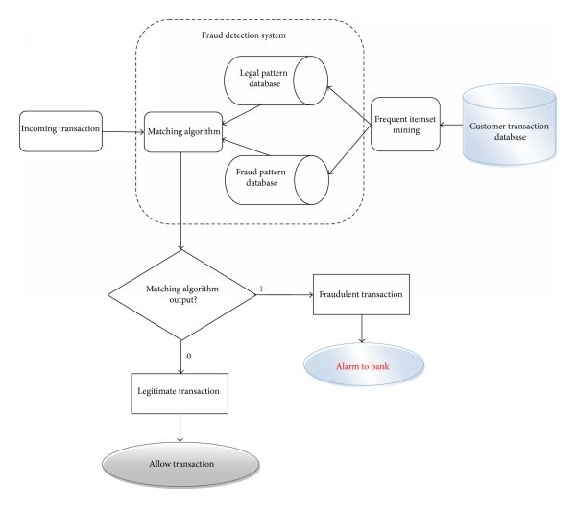
System Architecture/ Ideation Map
11 November 2021
Department of CSE
6

Slide 7
Project Implementation
Step 1: Import Packages
We’ll start our credit card fraud detection project by installing the required packages. Create a ‘main.py’ file and import these packages:
import numpy as np
import pandas as pd
import sklearn
from scipy.stats import norm
from scipy.stats import multivariate_normal
from sklearn.preprocessing import MinMaxScaler
import matplotlib.pyplot as plt
import seaborn as sns

Slide 8
Step 2: Look for Errors
Before we use the dataset, we should look for any errors and missing values in it. The presence of missing values can cause your model to give faulty results, rendering it inefficient and ineffective. Hence, we’ll read the dataset and look for any missing values:
df = pd.read_csv(‘creditcardfraud/creditcard.csv’)
# missing values
print(“missing values:”, df.isnull().values.any())
We found no missing values in this dataset, so we can proceed to the next step.

Slide 9
Step 3: Visualization
In this step of our credit card fraud detection project, we’ll visualize our data. Visualization helps in understanding what our data shows and reveals any patterns which we might have missed. Let’s create a plot of our dataset:
# plot normal and fraud
count_classes = pd.value_counts(df[‘Class’], sort=True)
count_classes.plot(kind=’bar’, rot=0)
plt.title(“Distributed Transactions”)
plt.xticks(range(2), [‘Normal’, ‘Fraud’])
plt.xlabel(“Class”)
plt.ylabel(“Frequency”)
plt.show()

Slide 10
Step 4: Splitting the Dataset
Create a ‘functions.py’ file. Here, we’ll add functions to implement the different stages of our algorithm. However, before we add those functions, let’s split our dataset into two sets, the validation set and the test set.
Step 5: Calculate Mean and Covariance Matrix
The following function will helps us calculate the mean and the covariance matrix:
def estimate_gaussian_params(X):
Step 6: Add the Final Touches
In our ‘main.py’ file, we’ll import and call the functions we implemented in the previous step for every set:
(Xtrain, Xtest, Xval, Ytest, Yval) = train_validation_splits(df)

Slide 11
(Xtrain, Xtest, Xval, Ytest, Yval) = train_validation_splits(df)
(mu, sigma) = estimate_gaussian_params(Xtrain)
# calculate gaussian pdf
p = multivariate_normal.pdf(Xtrain, mu, sigma)
pval = multivariate_normal.pdf(Xval, mu, sigma)
ptest = multivariate_normal.pdf(Xtest, mu, sigma)

Slide 12
Results and Discussion
In this application, we have considered fraud in the credit card was detected
In the testing the dataset is imported and detected the review successfully.

Slide 13
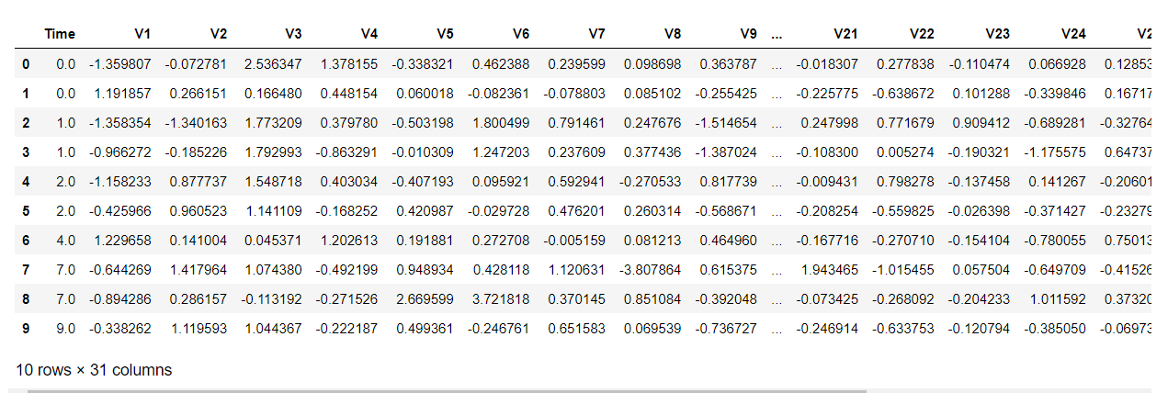
Sample snapshot

Slide 14
Conclusion
There you have it – a fully functional credit card fraud detection project!
If you have any questions or suggestions regarding this project, let us know by dropping a comment below. We’d love to hear from you.
With all the learnt skills you can get active on other competitive platforms as well to test your skills and get even more hands-on. If you are interested to learn more about the course, check out the page of the Execitive PG Program in Machine Learning & AI and talk to our career counsellor for more information.

Slide 15
References
Credit card fraud detection using Machine Learning Techniques John O. Awoyemi, Adebayo O. Adetunmbi , Samuel A. Oluwadare IEEE 2017
Real-time Credit Card Fraud Detection Using Machine Learning Anuruddha Thennakoon, Chee Bhagyani, Sasitha Premadasa,
ShalithaMihiranga, Nuwan Kuruwitaarachchi IEEE 2019
Analysis of Machine Learning Techniques for Credit Card Fraud Detection Abrar Nadim , Ibrahim Mohammad Sayem , Aapan Mutsuddy ,Mohammad Sanaullah Chowdhury IEEE 2019
Credit Card Fraud Detection Techniques Nikita Shirodkar , Pratiksha mandrekar,Rohit Shet Mandrekar , Rahul Sakhalkar,
K.M. Chaman Kumar , Shailendra Aswale IEEE 2020
Credit Card Fraud Detection Using Hidden Markov Model Abhinav Srivastava, Amal Kundu, Shamik sural, Arun Majumdar IEEE 2008
A new user-based model for credit card fraud detection based on artificial immune system . Neda Soltani, Mohammad Kazem Akbari, Mortaza Sargolzaei javanIEEE 2012

Slide 16
THANK YOU

